Slide 1


Design and Development of an Intelligent Real-Time Traffic Flow Prediction and Congestion Analysis System Using Long Short-Term Memory (LSTM) Deep Learning Networks
DEPARTMENT OF COMPUTER SCIENCE AND ENGINEERING
PRESENTED BY
Y. JOHNSON (REG NO:212922104025)
M. EVARENCE BESKI (REG NO:212922104016)
FINAL YEAR B.E (CSE)
GUIDED BY
Ms. A. Sunitha M.E, (Ph.d) AP/CSE

Slide 2
ABSTRACT
Traffic congestion is a major problem in urban areas, causing delays, fuel wastage, and pollution. Accurate real-time traffic prediction is essential for smart transportation systems.
Traditional statistical and machine learning models fail to effectively capture long-term temporal dependencies in traffic time-series data.
This project proposes an intelligent real-time traffic flow prediction and congestion analysis system using Long Short-Term Memory (LSTM) deep learning networks to improve forecasting accuracy.
The proposed system predicts short-term traffic flow and classifies congestion levels, helping authorities and commuters make better route decisions

Slide 3
OBJECTIVE
To develop and implement an LSTM-based real-time traffic flow prediction and congestion analysis system that improves short-term forecasting accuracy using time-series traffic data.

Slide 4
EXISTING SYSTEM
Traffic prediction mainly uses statistical models like ARIMA and traditional machine learning algorithms such as Linear Regression and SVM.
These models cannot effectively capture long-term temporal dependencies present in traffic time-series data.
Prediction accuracy decreases during peak hours and dynamic traffic conditions.
Most existing systems are not optimized for real-time congestion analysis in smart transportation environments

Slide 5
PROPOSED SYSTEM
The system uses Long Short-Term Memory (LSTM) deep learning networks to model sequential traffic data.
It captures long-term temporal patterns and improves short-term traffic flow forecasting accuracy.
The model performs real-time traffic prediction and classifies congestion levels (Low, Medium, High).
The system is scalable and suitable for intelligent transportation and smart city applications.

Slide 6
LITERATURE SURVEY

Slide 7
Optimizing Traffic Speed Prediction Using a Multi-Objective Genetic Algorithm-Enhanced RNN for Intelligent Transportation Systems Author: C .Swetha Priya and F .Sagayaraj Francis
This paper proposes a Multi-Objective Genetic Algorithm enhanced Recurrent Neural Network (RNN) model to optimize traffic speed prediction accuracy and model performance for intelligent transportation systems.
Advantages
Multi-objective optimization improves prediction accuracy and model efficiency simultaneously.
Enhances RNN performance by automatically selecting optimal hyperparameters.
Suitable for intelligent transportation systems requiring optimized and adaptive traffic speed prediction
Disadvantages
The integration of Genetic Algorithm with RNN increases computational complexity and processing time.
Requires careful parameter tuning for both the Genetic Algorithm and RNN to achieve optimal performance.
Higher implementation complexity compared to standard deep learning models

Slide 8
Performance and improvement of deep learning algorithms based on LSTM in traffic flow prediction Author: Wei Xu1, Eric Blancaflor , Mideth Abisado1
This paper analyzes the performance of Long Short-Term Memory (LSTM) deep learning models and proposes improvements to enhance accuracy in traffic flow prediction for intelligent transportation systems.
Advantages:
LSTM effectively captures long-term temporal dependencies in traffic time-series data.
Provides higher prediction accuracy compared to traditional statistical models.
Suitable for real-time traffic flow forecasting in intelligent transportation systems.
Disadvantages:
LSTM models require large amounts of historical traffic data for effective training.
Training deep learning models like LSTM can take longer computational time.
Model performance may decrease if traffic data contains noise or missing values.

Slide 9
A novel CNN‑GRU‑LSTM based deep learning model for accurate traffic prediction Author: Vandana Singh1, Sudip Kumar Sahana1,Vandana Bhattacharjee1
This paper proposes a hybrid deep learning architecture combining CNN, GRU, and LSTM networks to improve traffic flow prediction accuracy by capturing both spatial and temporal traffic patterns.
Advantages:
Captures both spatial features (via CNN) and temporal dependencies (via GRU and LSTM).
Provides higher prediction accuracy compared to traditional and single deep learning models.
Suitable for complex urban traffic environments with dynamic traffic variations
Disadvantages:
The hybrid CNN-GRU-LSTM model increases computational complexity and training time.
Requires large-scale traffic datasets for effective performance.
Higher implementation complexity compared to single-model approaches like LSTM alone.

Slide 10
SYSTEM REQUIREMENTS
SOFTWARE REQUIREMENTS
Operating System : Windows
Programming Language : Python
Deep Learning Framework : TensorFlow
Libraries : OpenCV, NumPy, Keras
IDE / Tool : Jupyter Notebook
HARDWARE REQUIREMENTS
Processor : Intel i5 or higher
RAM : Minimum 8 GB
Storage : 256 GB HDD / SSD
GPU (Optional) : NVIDIA GPU for faster training

Slide 11
ARCHITECTURE DIAGRAM
User
Presentation Layer
User interface
Traffic Visualization
Prediction Display
Application Layer
Traffic Prediction
Congestion Analysis
Real Time Monitoring
Intelligent layer
LSTM Deep Learning Model
Model Training
Feature Selection
Output Layer
Predicted Traffic Flow
Congestion Status
Visualization Reports
Data Layer
Traffic Dataset
Weather Data
Historical Traffic Records
Data processing Layer
Data Preprocessing
Null Value Handling
Data Normalization
Admin Dashboard

Slide 12
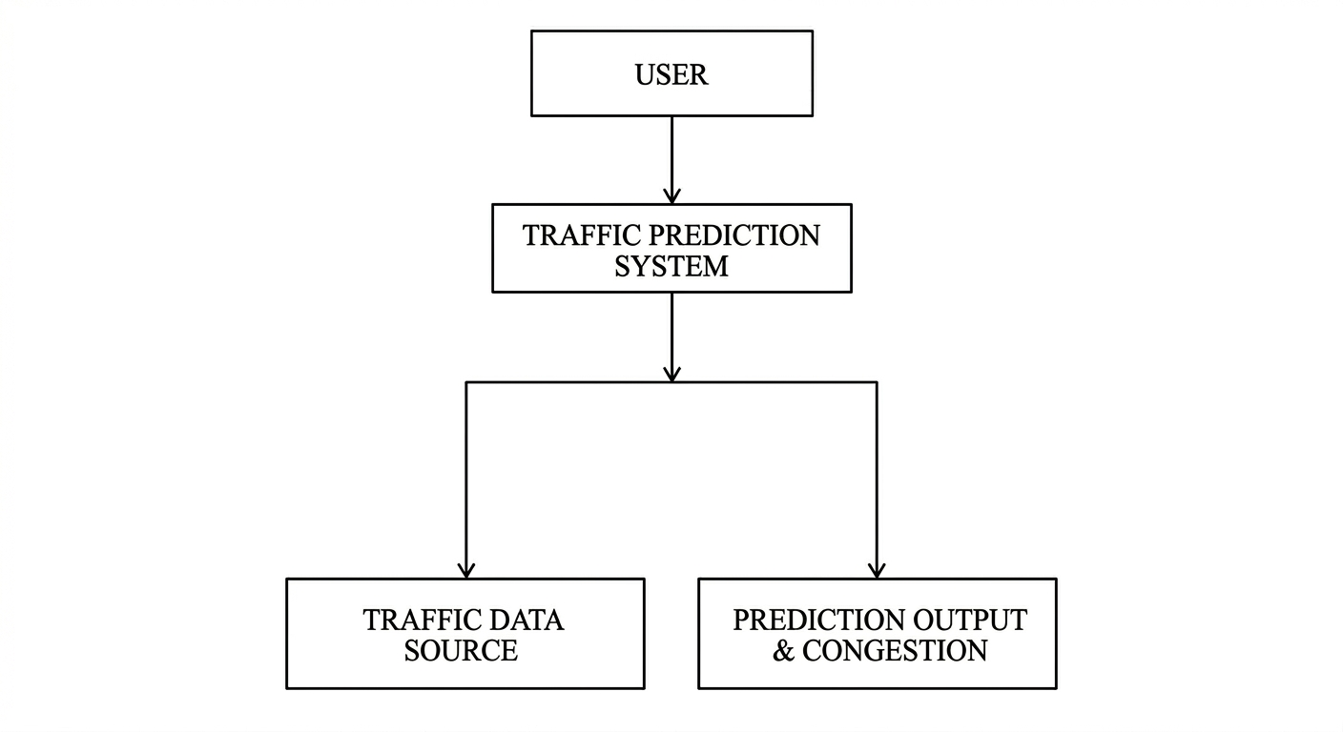
DATA FLOW DIAGRAM LEVEL 0
Request for Traffic Prediction

Slide 13
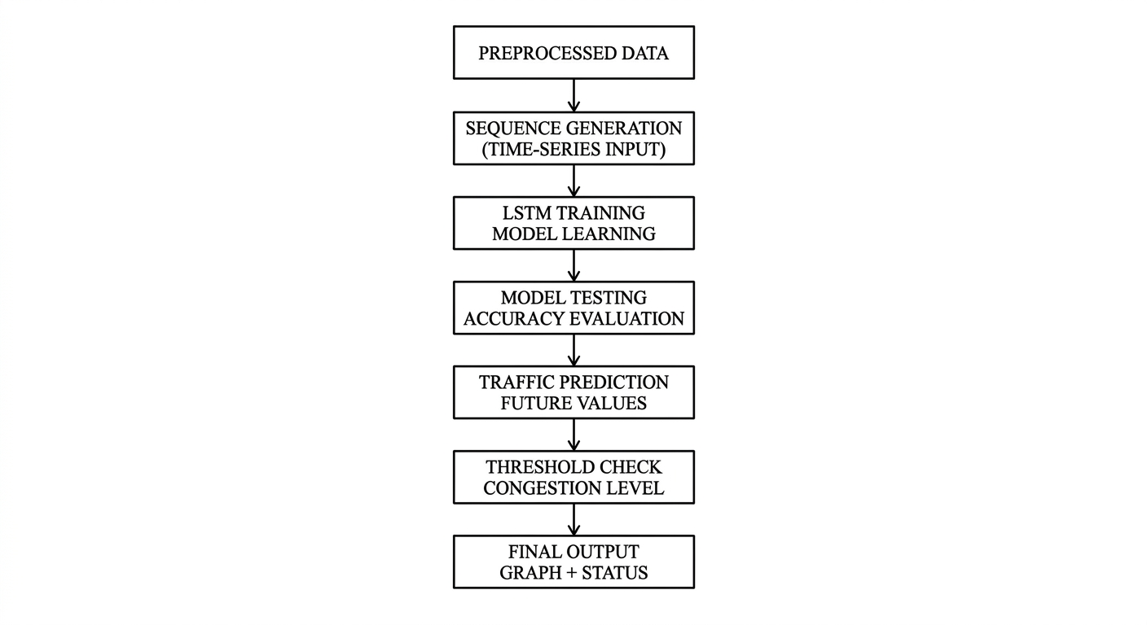
DATA FLOW DIAGRAM LEVEL 1

Slide 14
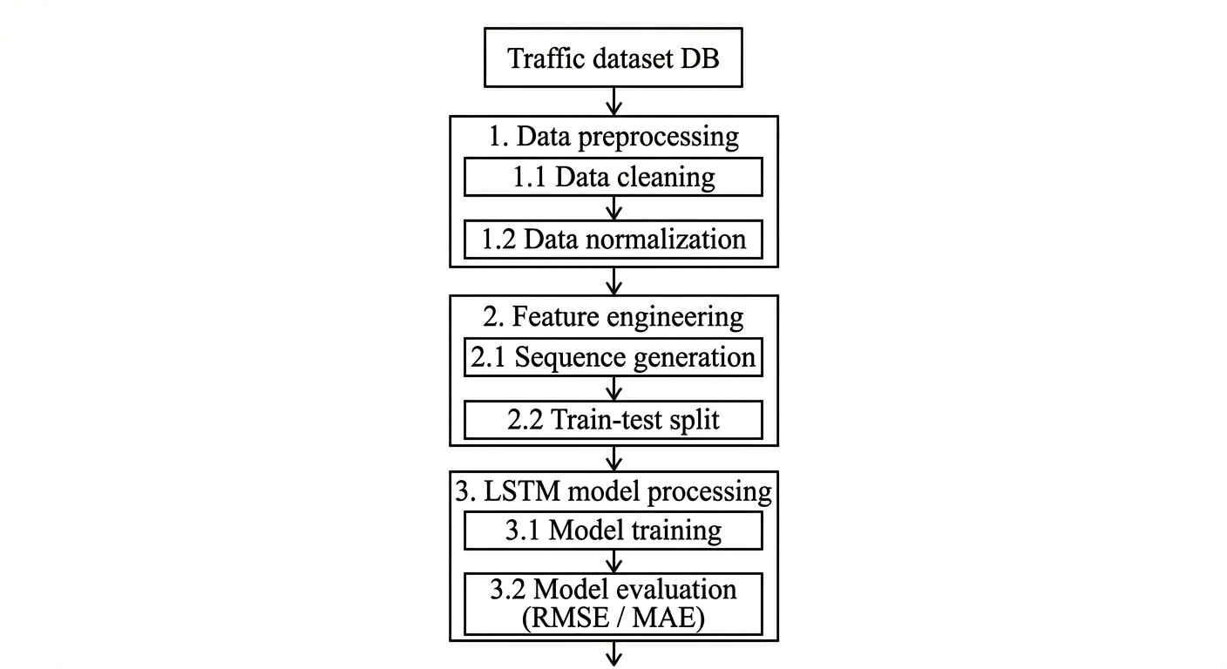
DATA FLOW DIAGRAM LEVEL 2

Slide 15
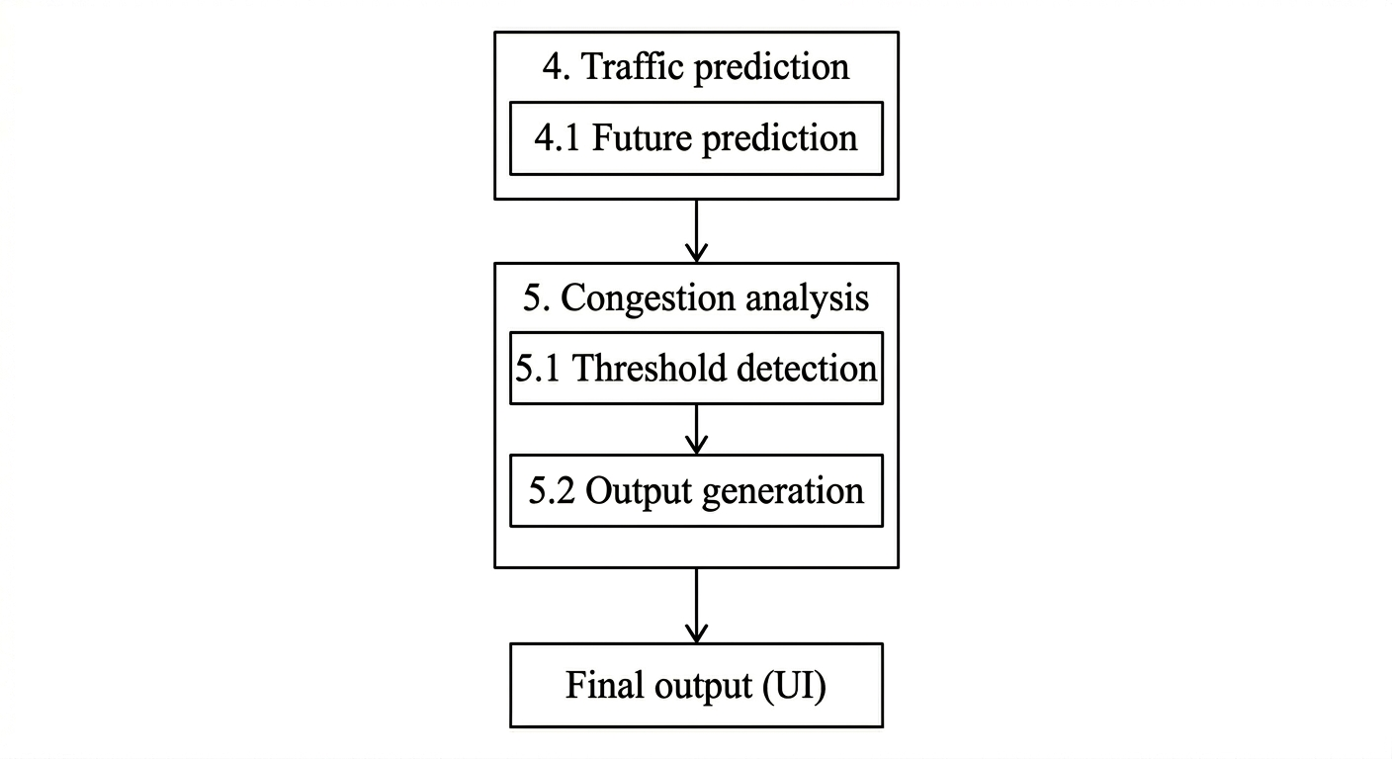
DATA FLOW DIAGRAM LEVEL 2(Contd.)

Slide 16
MODULES AND MODULES DESCRIPTION

Slide 17
MODULES
1. Data Collection Module
2. Data Preprocessing Module
3. Feature Engineering Module
4. LSTM Model Development Module
5. Traffic Prediction Module
6. Congestion Analysis And Visualization Module

Slide 18
1.DATA COLLECTION MODULE
Collect historical traffic flow data from public traffic datasets or sensors.
Gather time-based traffic information such as vehicle count, speed, and timestamps.
Store collected data in a structured format for further processing.
Traffic Data Sources
Data Accquisition
Raw Data Storage

Slide 19
2. DATA PREPROCESSING MODULE
Remove missing values and inconsistent traffic records.
Normalize traffic data to improve model training performance.
Convert raw traffic data into time-series sequences suitable for prediction.
Raw Traffic Data
Data Cleaning
Missing Value Handle
Data Normalization

Slide 20
3. FEATURE ENGINEERING MODULE
Extract important features such as traffic volume, time intervals, and day patterns.
Create input sequences required for the LSTM model.
Split the dataset into training and testing sets.
Preprocessed Data
Time-Series Convert
Sequence Generation
Train-Test Spilt

Slide 21
4. LSTM MODEL DEVELOPMENT MODULE
Design the Long Short-Term Memory (LSTM) neural network architecture.
Train the model using historical traffic data to learn temporal patterns.
Optimize model parameters to improve prediction accuracy
Input Sequences
LSTM Model Training
Pattern Learning
Model Evaluation

Slide 22
5.TRAFFIC PREDICTION MODULE
Use the trained LSTM model to predict future traffic flow values.
Generate short-term traffic forecasts for upcoming time intervals.
Analyze predicted traffic patterns for decision making
Trained Model
Predict Future Flow
Generate Forecast
Predicted output

Slide 23
6. CONGESTION ANALYSIS AND VISUALIZATION MODULE
Classify predicted traffic levels into congestion categories (Low, Medium, High).
Visualize prediction results using graphs and charts.
Provide insights to support intelligent traffic management.
Level Classification
Predicted Traffic
Threshold Check
Visualization

Slide 24
THANK YOU

